Slide 1

DTAA ADVISOR: SYSTEM
ACTIVATED
AI-Powered Bespoke
Double Tax Treaty
Advisory Tool CA Anoop Kapoor , Aug 26, Capstone project

Slide 2
INEFFICIENCY
DETECTED: THE
PROBLEM
Analyzing current bottlenecks in manual
tax advisory
01
02
03
Time Factor
90+ Treaties
ITA 2025 Complexities
A single DTAA advisory takes 2–4 hours of senior CA
India has over 90 active DTAAs, each with unique
Form 15CA/15CB/10F replaced by Form 145/146/41,
time. Multiply by 100+ transactions a year.
rates, MLI changes, and anti-avoidance rules.
causing widespread compliance gaps.

Slide 3
SOLUTION: DTAA ADVISOR
SUITE
25
5
<30s
DTAAs Covered
Integrated Modules
Advisory Speed
25 DTAAs Covered
5 Integrated Modules
<30s Per Advisory
High-speed AI analysis for Indian Chartered Accountants

Slide 4

Core Stack
Form 15CA
Streamlit (UI) |
Form 145 (Section
Claude 4.5 (AI
397(3)(d))
Engine) | PyPDF2
(Treaty Reader)
Form 15CB
Form 10F
Form 146 (Section
Form 41 (Rule 75 |
397(3)(d))
Section 159(8))
SYSTEM
ARCHITECTURE
Section 195
Section 393 (TDS on NR Payments)
Technical stack and ITA 2025 data
mapping

Slide 5
SECURITY PROTOCOLS
Integrity
Access control and data
protection mechanisms
Authorization
Authentication occurs via the sidebar.
Verification loads the Firm's API key.
Verification
Authorization unlocks the AI Advisory
and Notice Reply modules. Integrity is
maintained by excluding keys from
version control via .gitignore.
Authentication

Slide 6
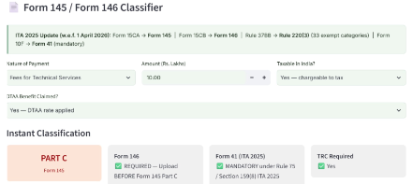
01
02
Phase 2: Expansion
Phase 3: Automation
Scaling to 90+ DTAAs and
Auto-drafting Form 145/146
implementing a Google Sheets
directly from AI advisory output.
FUTURE
DB for user management.
UPGRADES:
03
PHASES 2-4
Phase 4: Mobility
Scaling the DTAA Advisor ecosystem
Deployment of a mobile app for
CA field use and secure client
portals.

Slide 7

Built by CA Anoop
Kapoor | Income Tax
Act, 2025 | Income
Tax Rules, 2026
Thank
You
Making Bespoke Cross-Border Tax
Compliance Instant

